Slide 1
Project 1 Air Quality in Italy Linear Regression Model Comparison
Done by:
Mohammad Kharoof
Obada Issa
Yara Rashed

Slide 2
Introduction
Air pollution is one of the most dangerous problems in the planet. It can play major roles in destroying the lives of millions of people as it harms crops, livestock and even humans. Hence, it is very important for people to make their next move to tackle the problem and solve it in any possible way before it is too late.
Data science has improved exponentially over the last years and it has opened the doors to multiple ways of engineering all of that data. One way was to apply machine learning to the data in order to predict something based on an existing dataset in a set of algorithms called unsupervised machine learning algorithms.
As an example of these algorithms we have the Linear Regression (LR) machine learning model which heavily relies on, as the name suggests, linear regression and some of its statistical analysis techniques such as the Root Mean Square Error (RMSE) and the coefficient of determination (R2). The LR model is used when the data is continuous and not classifiers.
Smart Bridge has offered the Italian Air Quality dataset which has 153 datapoints and 5 features with one label which is the Ozone.
Our job is to process this dataset, clean it, visualize it, and come up with an LR model that can predict how bad things would go if one or more of these causes (features) happen to have some continuous value.

Slide 3
Overview of the Project
As mentioned before, this dataset is from an Italian city and was measured using sensors which have recorded depletion in the Ozone’s layer.
These recorded features contained the following:
Ozone;
Solar Radiation;
Wind;
Temp;
Month;
Day.
To begin with, this data must have all of its null values handled correctly. In this project, we will use the mean strategy for all datapoints as all of the features have continuous data. Once that is done, we will clean it from all outliers using the z-score and IQR methods. The methodology will be explained later.
Now that our dataset is ready, we start with the analysis and see which visualizations are needed to see through the dataset to predict the outcome of the models.

Slide 4
Emphasis on the Problem
Pollution in general is a serious topic and something has to be done. In this project, we aim to create a model to predict what would happen if some certain values were given to the recorded features. This may ultimately help other data scientists to asses how certain infrastructures should react for them to cooperate and avoid excessive pollution.

Slide 5
Objectives
To process the dataset provided.
Clean it from all null values entries.
Clean it from all outlier values.
Visualize and understand the dataset.
Apply various Linear Regression algorithms on the dataset.
Using Simple Linear Regression algorithm to find out the relationship between Ozone depletion and temperature.
Using Multiple Linear Regression model to find the relationship between Ozone depletion, wind and solar radiation.
Compare both models based on factors such as RMSE, R2, interception and slope coefficient.

Slide 6
Dataset Description
The dataset includes various input features like:
Ozone: Mean ozone in parts per billion from 1300 to 1500 hours at Roosevelt The target variable is ‘Ozone’.
Solar.R: Solar radiation in Langleys in the frequency band 4000-7700 Angstroms from 0800 to 1200 hours
Wind: Average wind speed in miles per hour at 0700 and 1000 hours.
Temp: Maximum daily temperature in degrees Fahrenheit.
Month numeric Month (1–12)

Slide 7
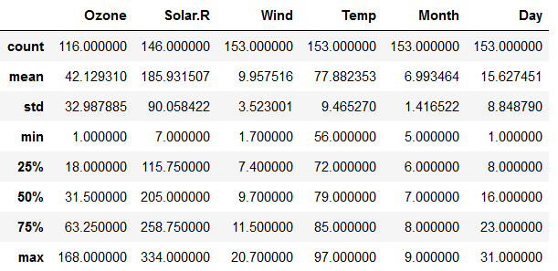
EDA
Notes:
Count: How many values were recorded.
Mean: mean.
std: standard deviation.
Min: minimum value.
25%: 25th percentile
50%: 50th percentile
75%: 75th percentile
Max: maximum value.

Slide 8
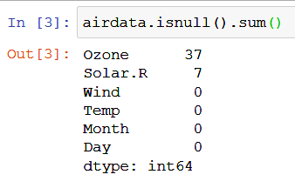
EDA
We started with this count of null values.

Slide 9
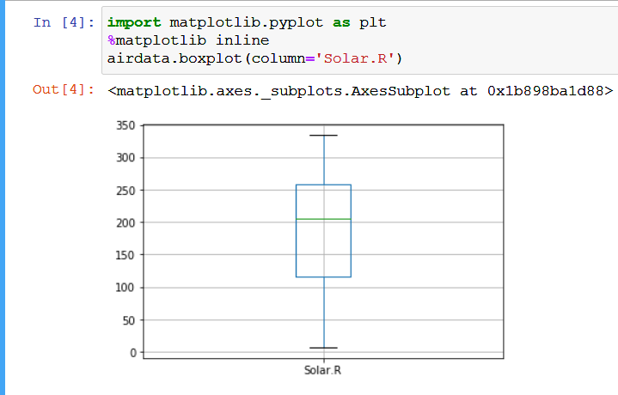
EDA
Boxplot for the Solar Radiation.

Slide 10
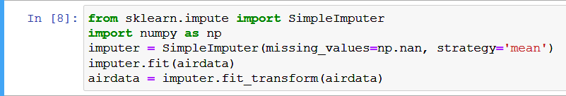
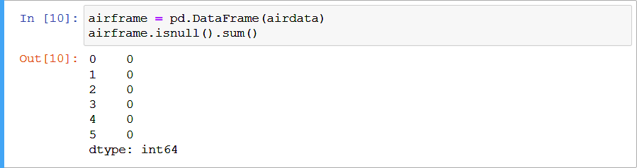
EDA
Cleaning our dataset of all null values by setting them to the mean value of each feature.

Slide 11
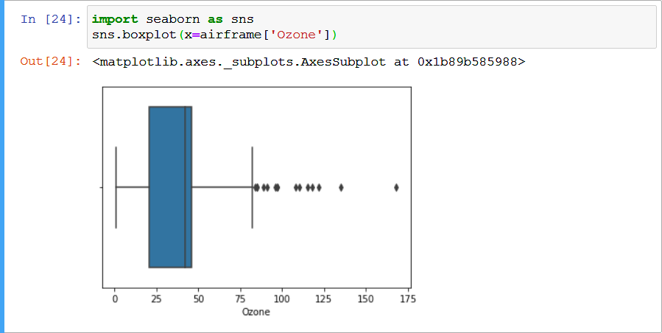
EDA
Analyzing the outliers of Ozone through a boxplot.

Slide 12
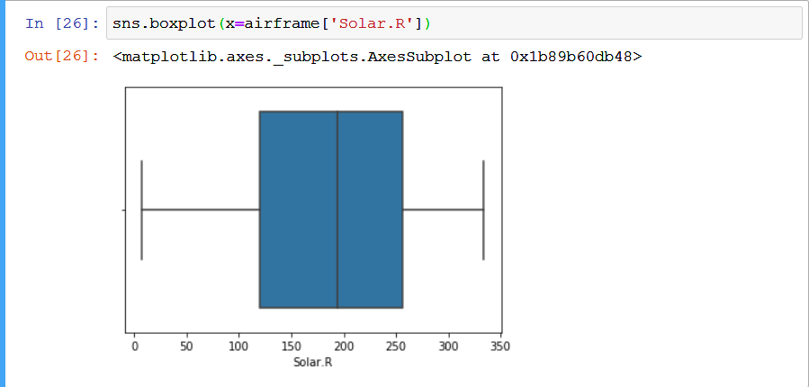
EDA
Analyzing the outliers of Solar Radiation through a boxplot.

Slide 13
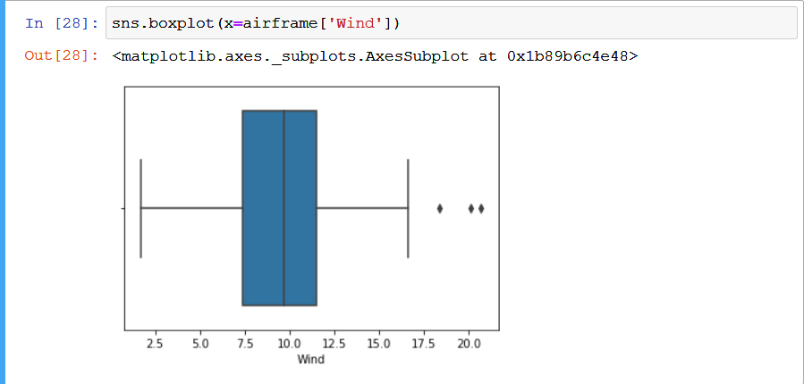
EDA
Analyzing the outliers of wind through a boxplot.

Slide 14

EDA
Analyzing the outliers of temperature through a boxplot.

Slide 15

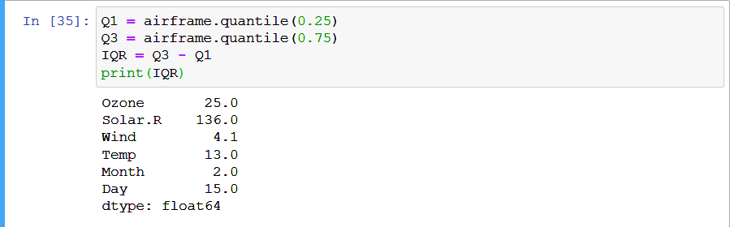
EDA
Cleaning the data of outliers using z-score and IQR.

Slide 16
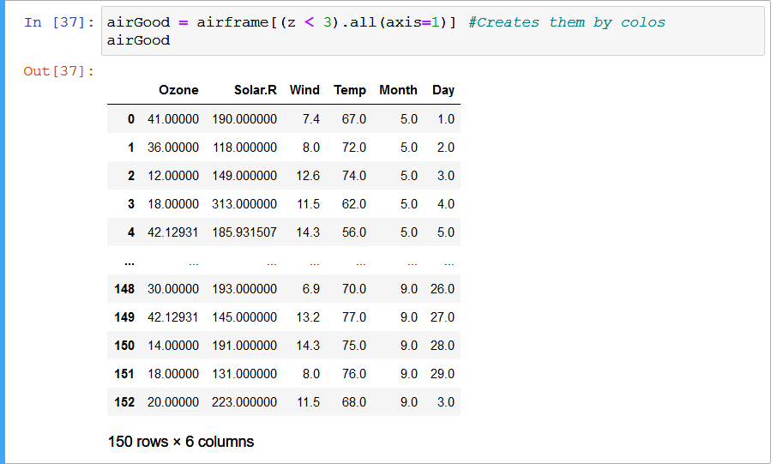
EDA
Cleaning using the z-score with threshold of 3. The output has lost 3 arrows of outliers which is a good sign. However, IQR might be able to do more.

Slide 17
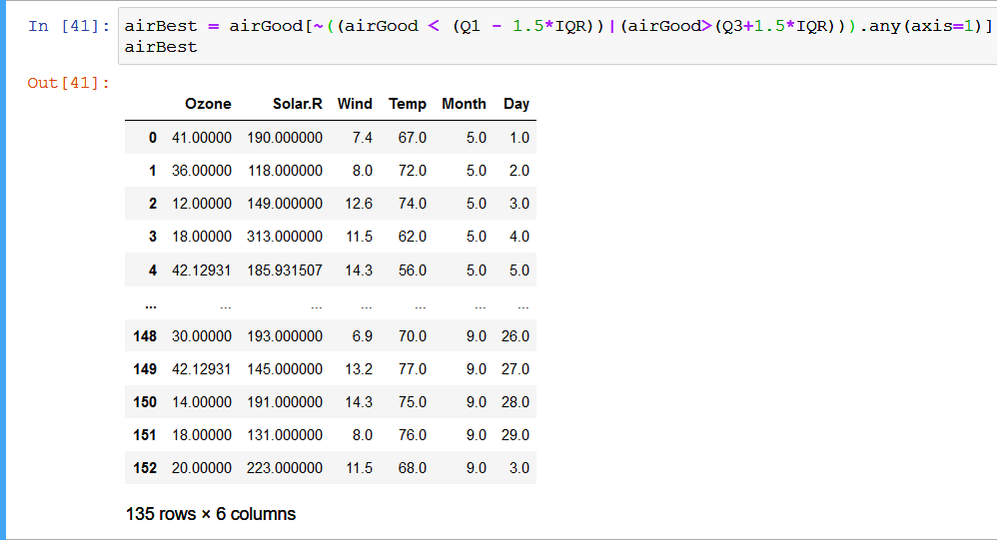
EDA
Cleaning using the IQR. The dataset has lost about 18 datapoints which were noisy outliers. Now, we are almost prepared to start with machine learning.

Slide 18
EDA
Dividing the dataset into features labels. The labels will contain the Ozone depletion values while the features will have the other 5 values.

Slide 19
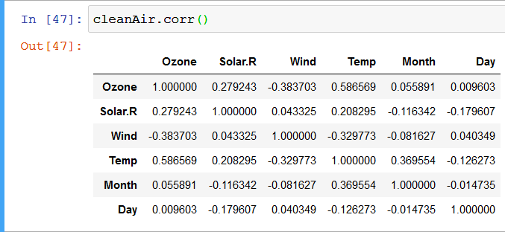
EDA
The correlation between every value in the dataset. This is so important as it tells us which value will impact the other values the most.

Slide 20
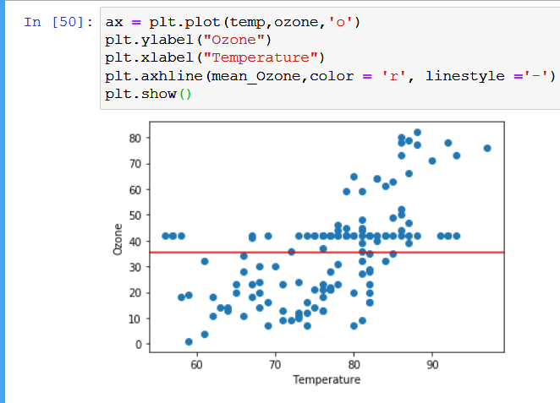
EDA
Scatter plot to show that variance in the dataset. Question is, does this graph represent a line?

Slide 21
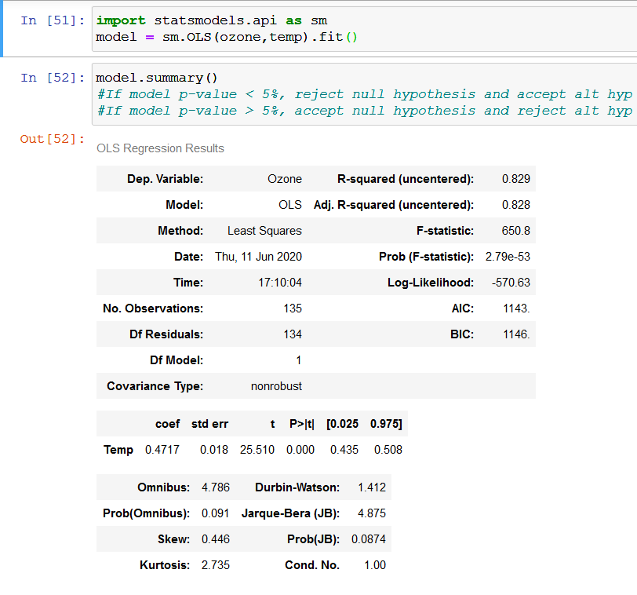
EDA
R2 = 0.829
AIC = 1144
BIC = 1146
P = 0
0.00 is < 5% so we accept alt hyp

Slide 22
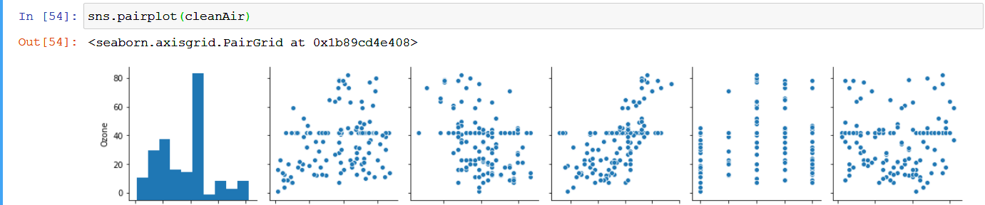
EDA
Ozone Solar.R Wind Temp Month Day

Slide 23
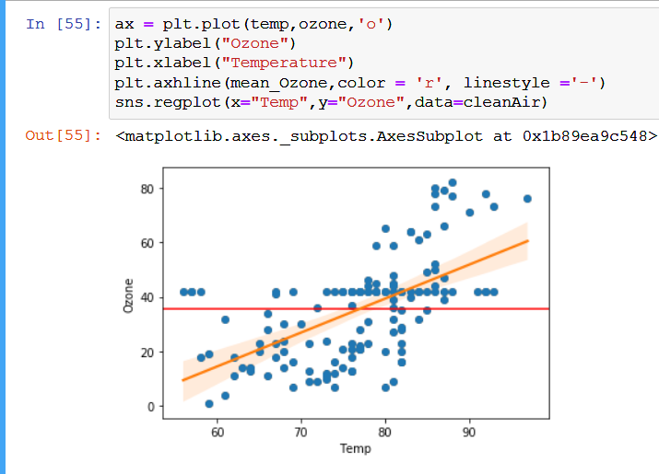
EDA
Ozone vs. Temp

Slide 24
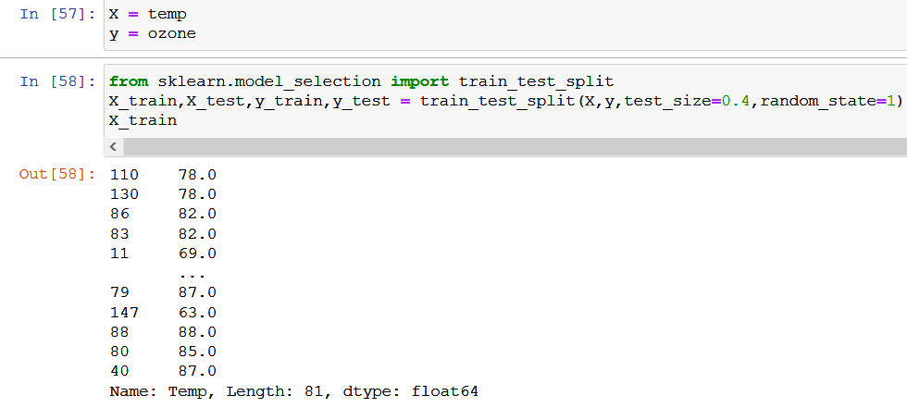
ML
The X is the common name of the features, while y is the label is kind of like y(X) will predict something for us. Anyways, we are splitting the dataset into 4 different sets. The training will have 60% whereas the testing will have the remaining 40%

Slide 25
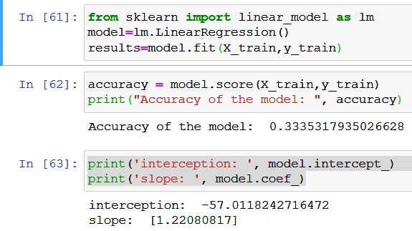
ML
Accuracy = 0.3335
Interception = -57.01182
Slope coefficient = 1.221

Slide 26
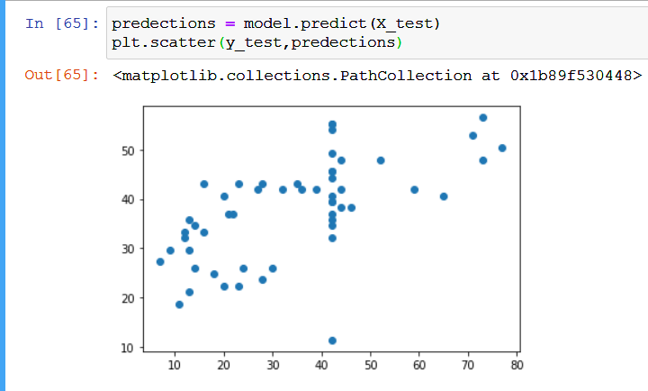
ML
This looks familiar but it is not accurate at all!

Slide 27
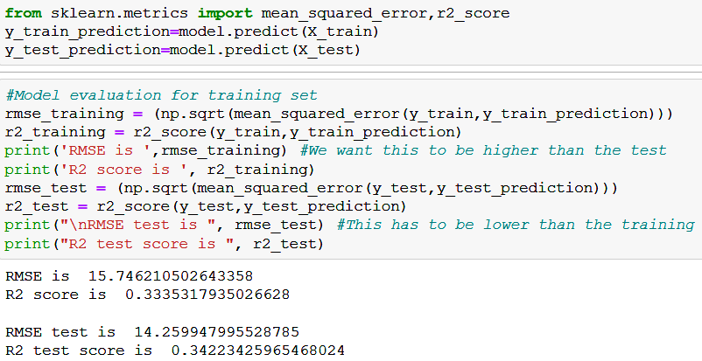
ML
RMSE training = 15.75
R2 training = 0.33
RMSE test = 14.26
R2 test = 0.3422
We can note that the RMSE of test is lower which is good. However, this is not accurate at all.

Slide 28
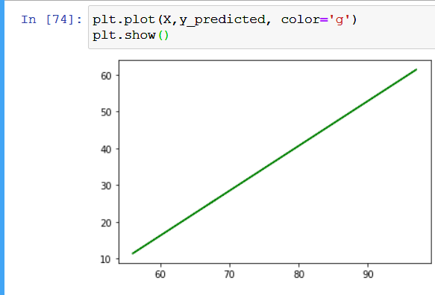
ML
Predicted line based on the model made.

Slide 29

ML
Multiple Linear Regression for Ozone vs Solar.R and Wind

Slide 30
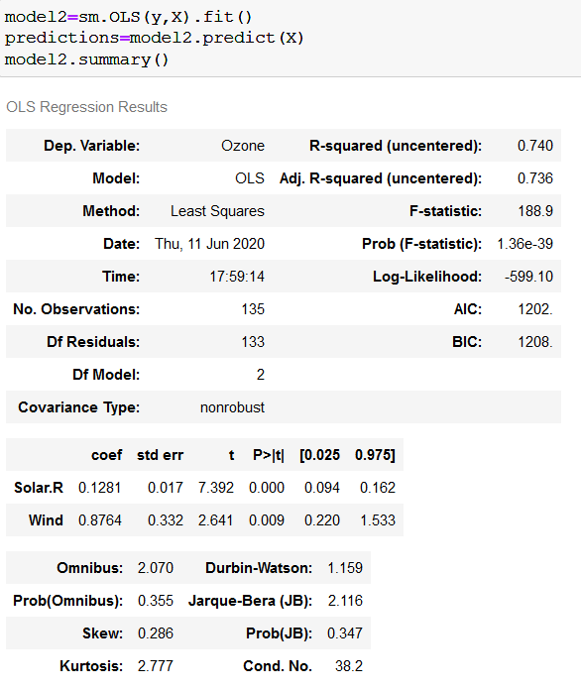
ML
R2 = 0.74
AIC = 1202
BIC 1208
P = 0
0.00 is < 5% so we accept alt hypothesis

Slide 31
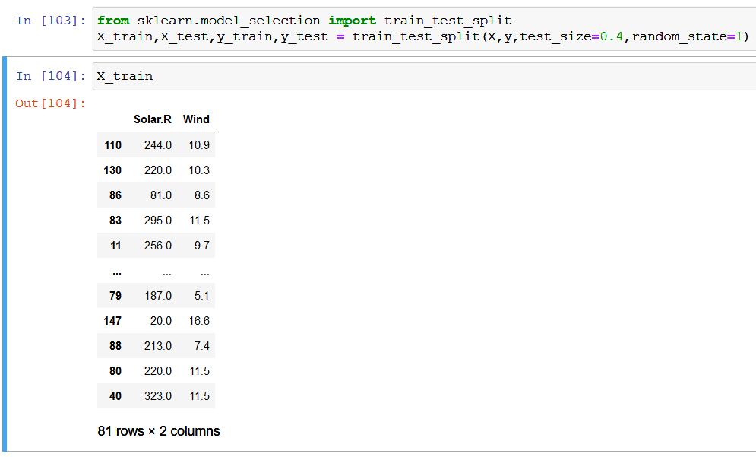
ML
Division of training and testing datasets.

Slide 32
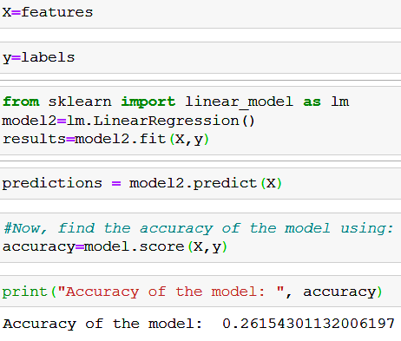
ML
Accuracy = 0.26 which is lower than the simple linear regression.

Slide 33
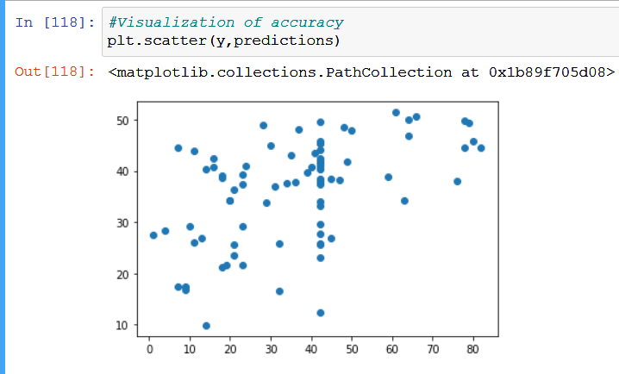
ML
This is so much worse than the simple linear regression model.

Slide 34
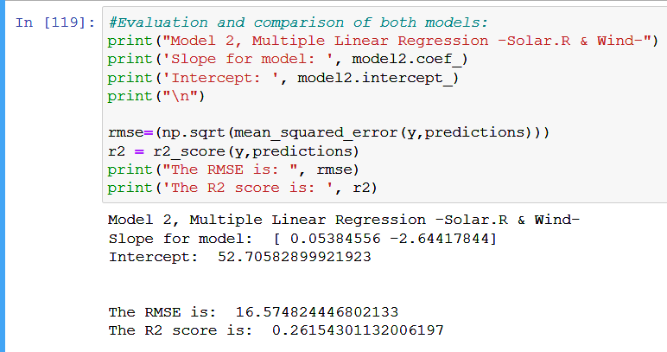
ML
R2 = 0.26
RMSE = 16.57
Intercept = 52.71
Coefficient = 0.05384556 -2.64417844

Slide 35
ML
Model | R2 | RMSE | AIC | BIC | P | Coef. | Interception | Accuracy
Simple Linear Regression model | 0.34 | 14.26 | 114 | 1146 | 0 | 1.22 | -57.01 | 0.33
Multiple Linear Regression model | 0.26 | 16.57 | 1202 | 1208 | 0 | 0.05384556 -2.64417844 | 52.71 | 0.26
Results

Slide 36
Summary and Findings
It can be seen from the very beginning, the relationship all features have with that one label.
We have started with temperature and ended up with a bad training and testing scores. This means that we are underfitting.
We have then tried to include 2 features in a multiple Linear Regression model instead of one. This multiple Linear Regression has done poorly due to overfitting.
We were fortunate enough not to encounter strings in this dataset unlike what we had with the flights.csv.
This dataset was simple to clean and visualize due to its low number of features. However, It is believed that Italy will need more data points. Since this data will have the model underfit.

